Slide 1
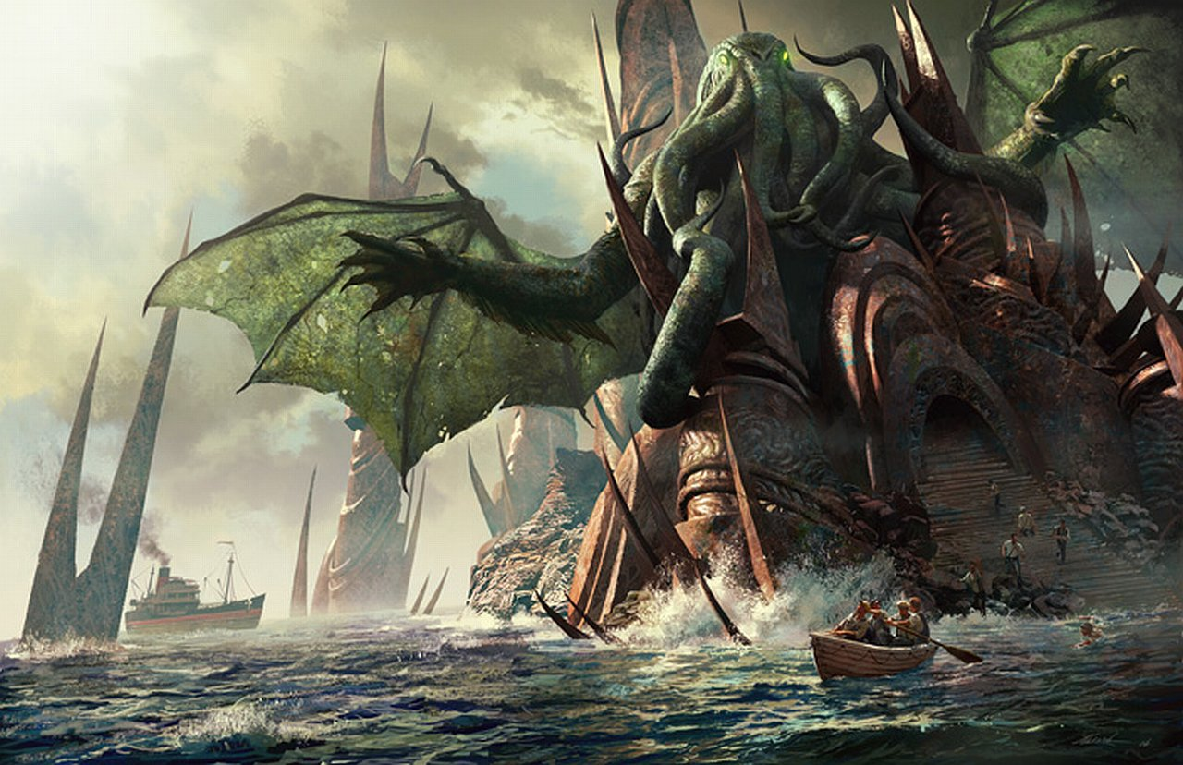
H.P. Lovecraft, “The Call of Cthulhu”

Slide 2
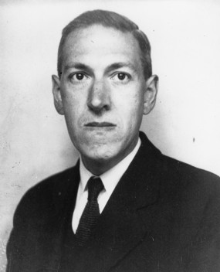
H.P. Lovecraft (1890-1937)
Born Providence, Rhode Island
First published story at age 31
Best known for fiction, but also prolific in poetry, non-fiction, journalism, letters
Died at age 46

Slide 3
“Weird” Fiction
A sub-genre of “speculative fiction”:
Fiction with supernatural, fantastical, or futuristic (“speculative”) elements
“Weird fiction” or “weird tales”:
Encompasses elements of horror and fantasy
Usually refers to a genre of its own
Popular especially in in the 1920s and 1930s
Related to “pulp” magazine (e.g. Weird Tales, 1923-1954)

Slide 4
Lovecraft, “Supernatural Horror in Literature” (1927)
“The oldest and strongest emotion of mankind is fear, and the oldest and strongest kind of fear is fear of the unknown. These facts few psychologists will dispute, and their admitted truth must establish for all time the genuineness and dignity of the weirdly horrible tale as a literary form.”

Slide 5
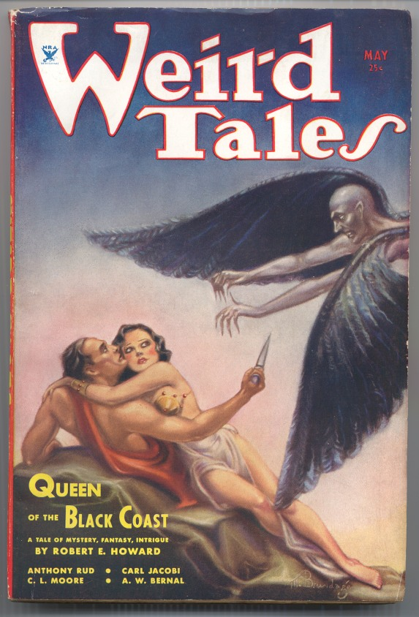
Based in Chicago, Illinois
“Pulp” magazine
1923-1954
Published “The Call of Cthulhu” in 1928
Contributors included:
H.P. Lovecraft
Robert Bloch (Psycho)
Robert E. Howard (Conan the Barbarian series)
Ray Bradbury

Slide 6
Lovecraft’s Literary Legacy
"[T]he only real horror in most of these fictions is the horror of bad taste and bad art." (Critic Edmund Wilson, 1945)
“The twentieth century's greatest practitioner of the classic horror tale.” (Stephen King, 1995)
Huge influence on horror and speculative fiction
Bust for award statue for World Fantasy Award (more on this later)

Slide 7

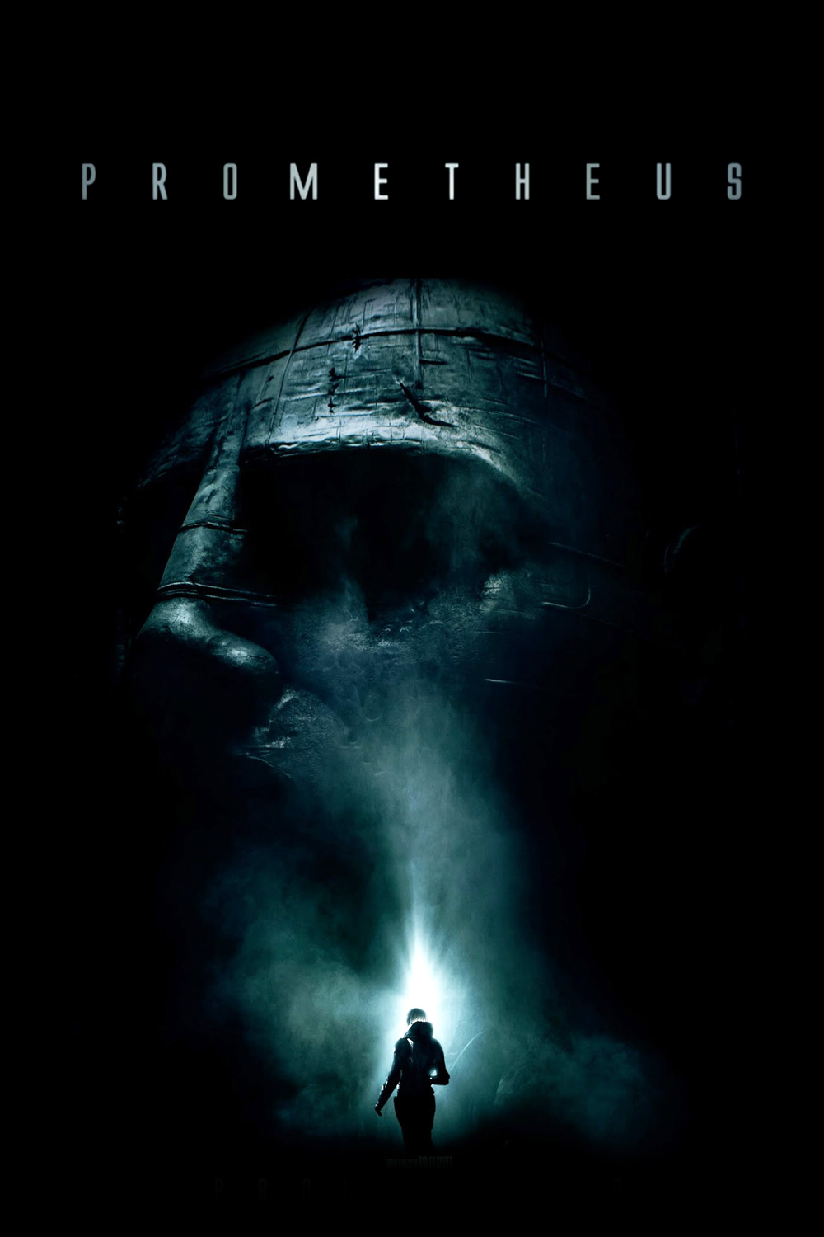
Lovecraft’s At the Mountains of Madness (1936)
The Thing (1982) Prometheus (2012)
Dir. John Carpenter Dir. Ridley Scott

Slide 8
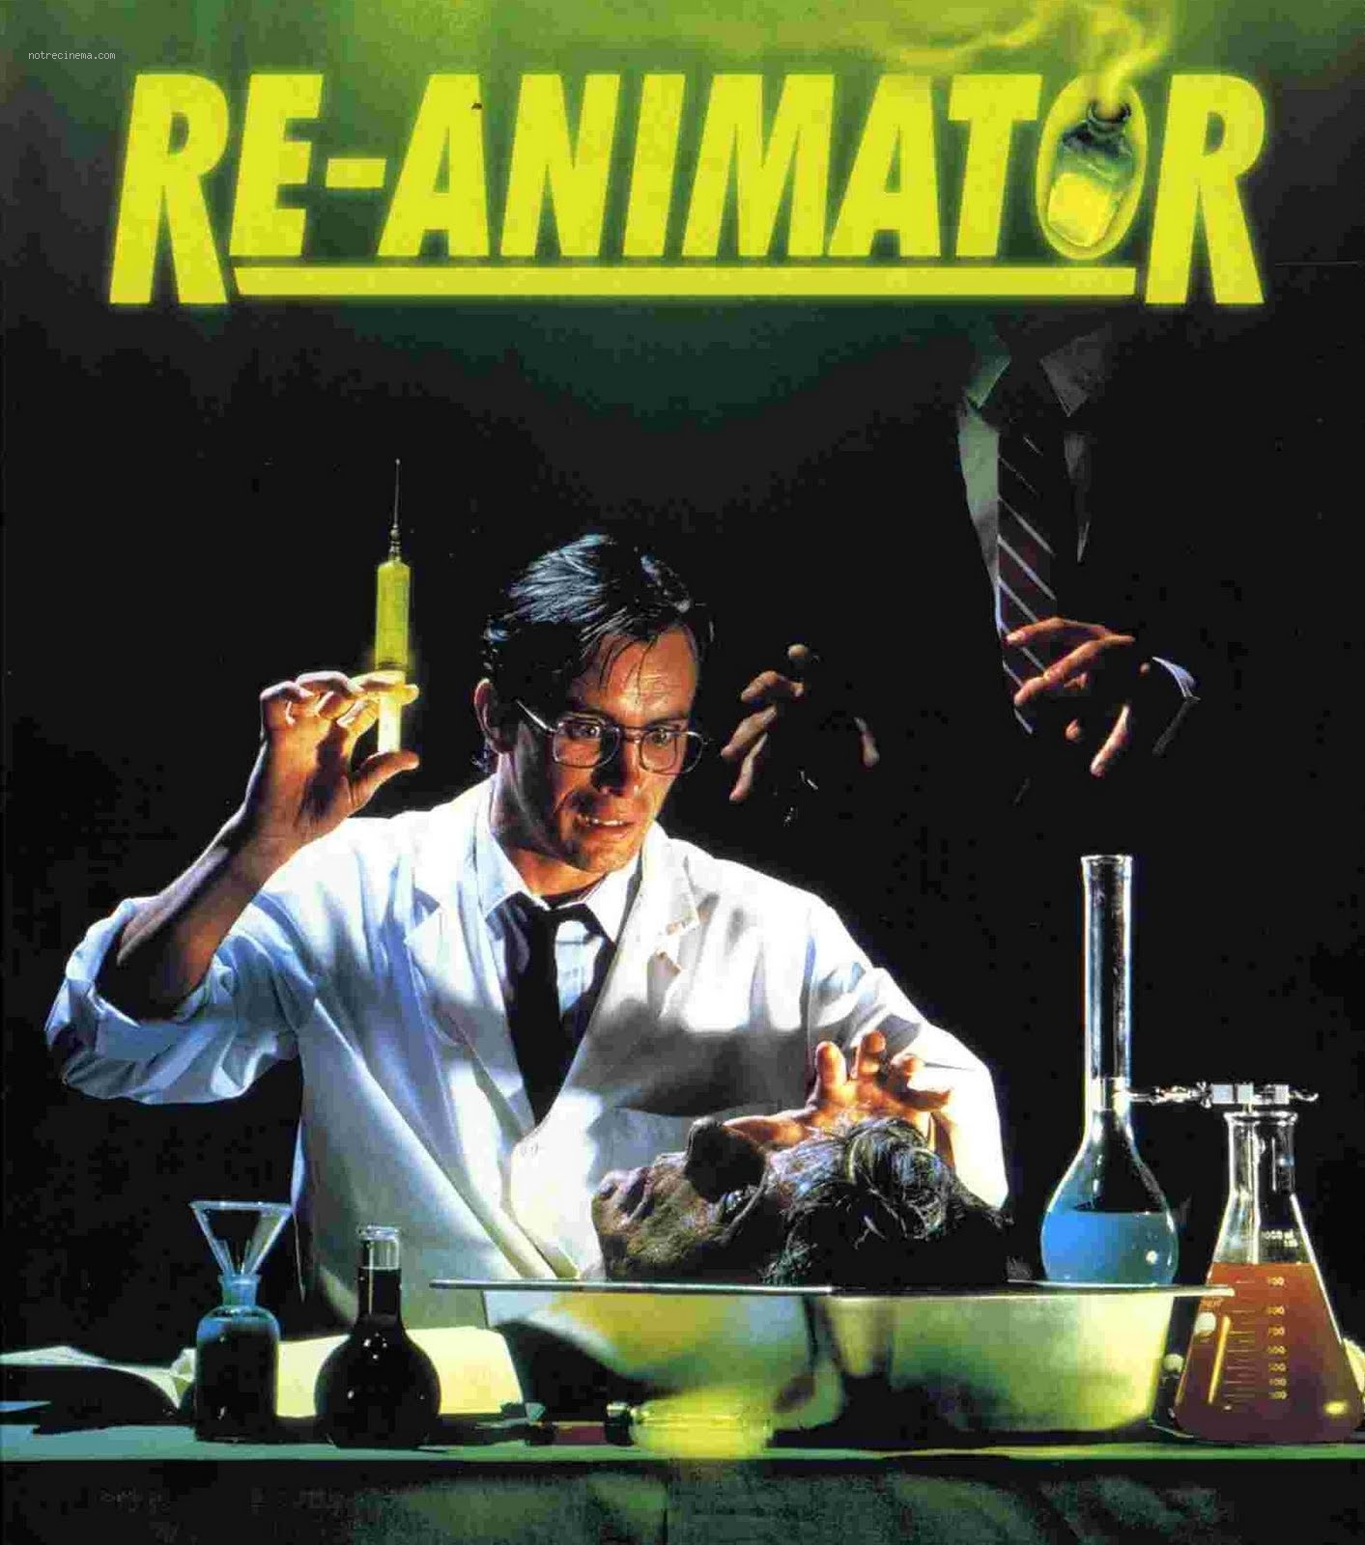
Lovecraft’s “Herbert West—Reanimator” (1922)
Dir. Stuart Gordon, 1985

Slide 9
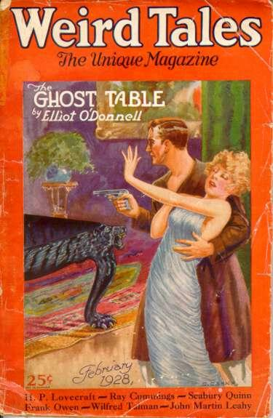
“The Call of Cthulhu”
Written 1926
Published in Weird Tales (1928)
Lovecraft’s best-known tale
Spawned “Cthulhu Mythos” – a shared fictional universe

Slide 10
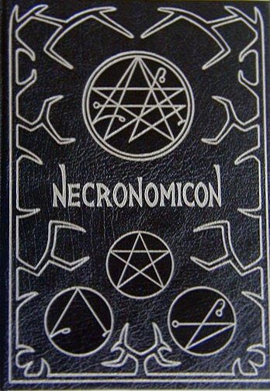
Necronomicon
Fictional book of magic
Written by “Mad Arab Abdul Alhazred”*
Cited by other authors writing in the “Cthulhu Mythos”
Appears in Evil Dead and Friday the 13th series

Slide 11
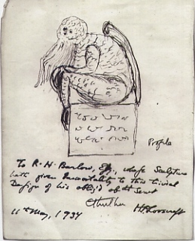
Lovecraft’s Sketch of Cthulhu

Slide 12
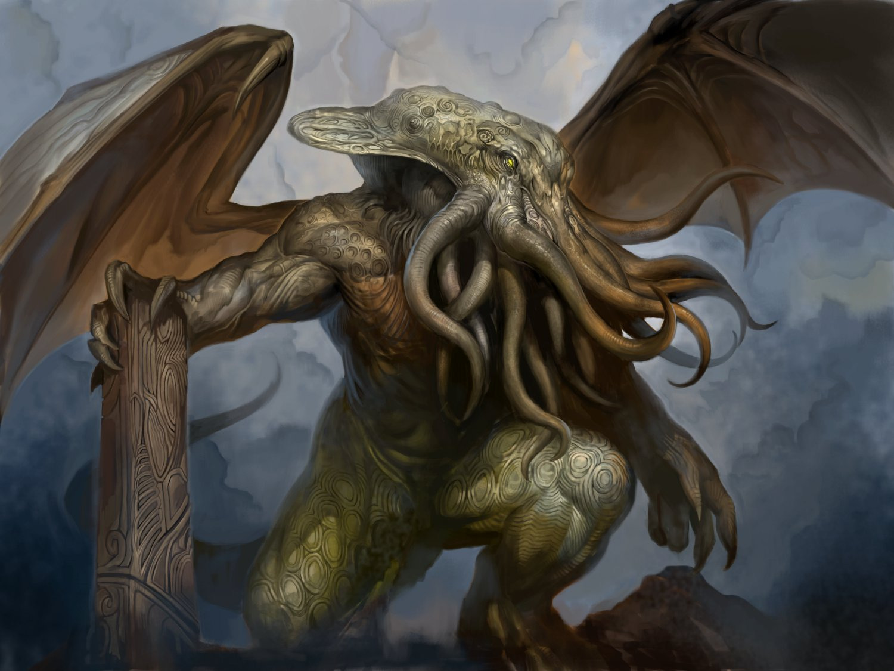
Cthulhu Fan Art

Slide 13
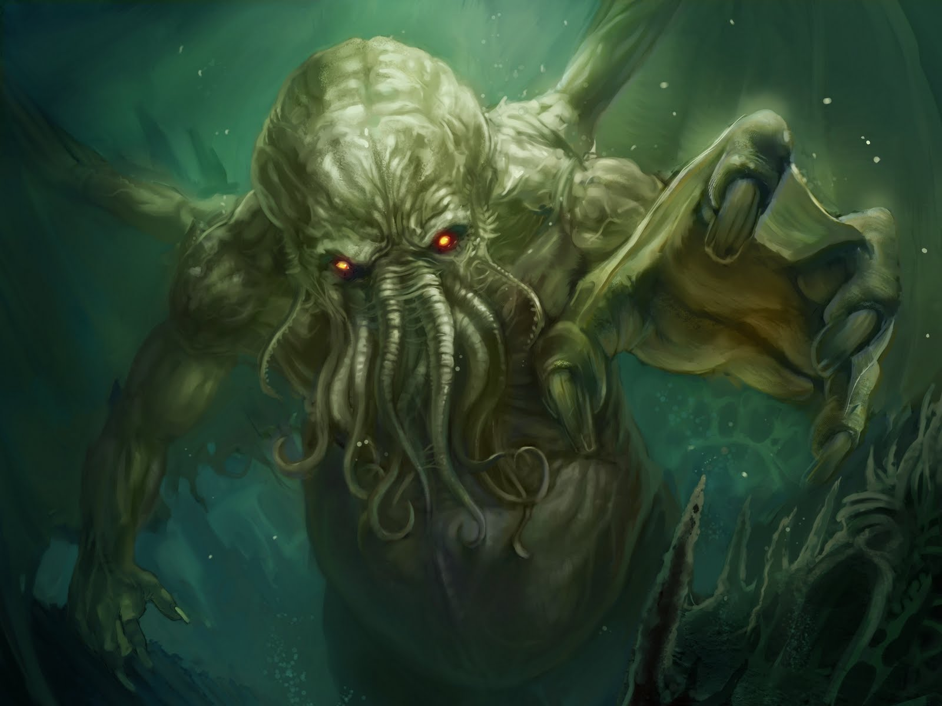
Cthulhu Fan Art

Slide 14
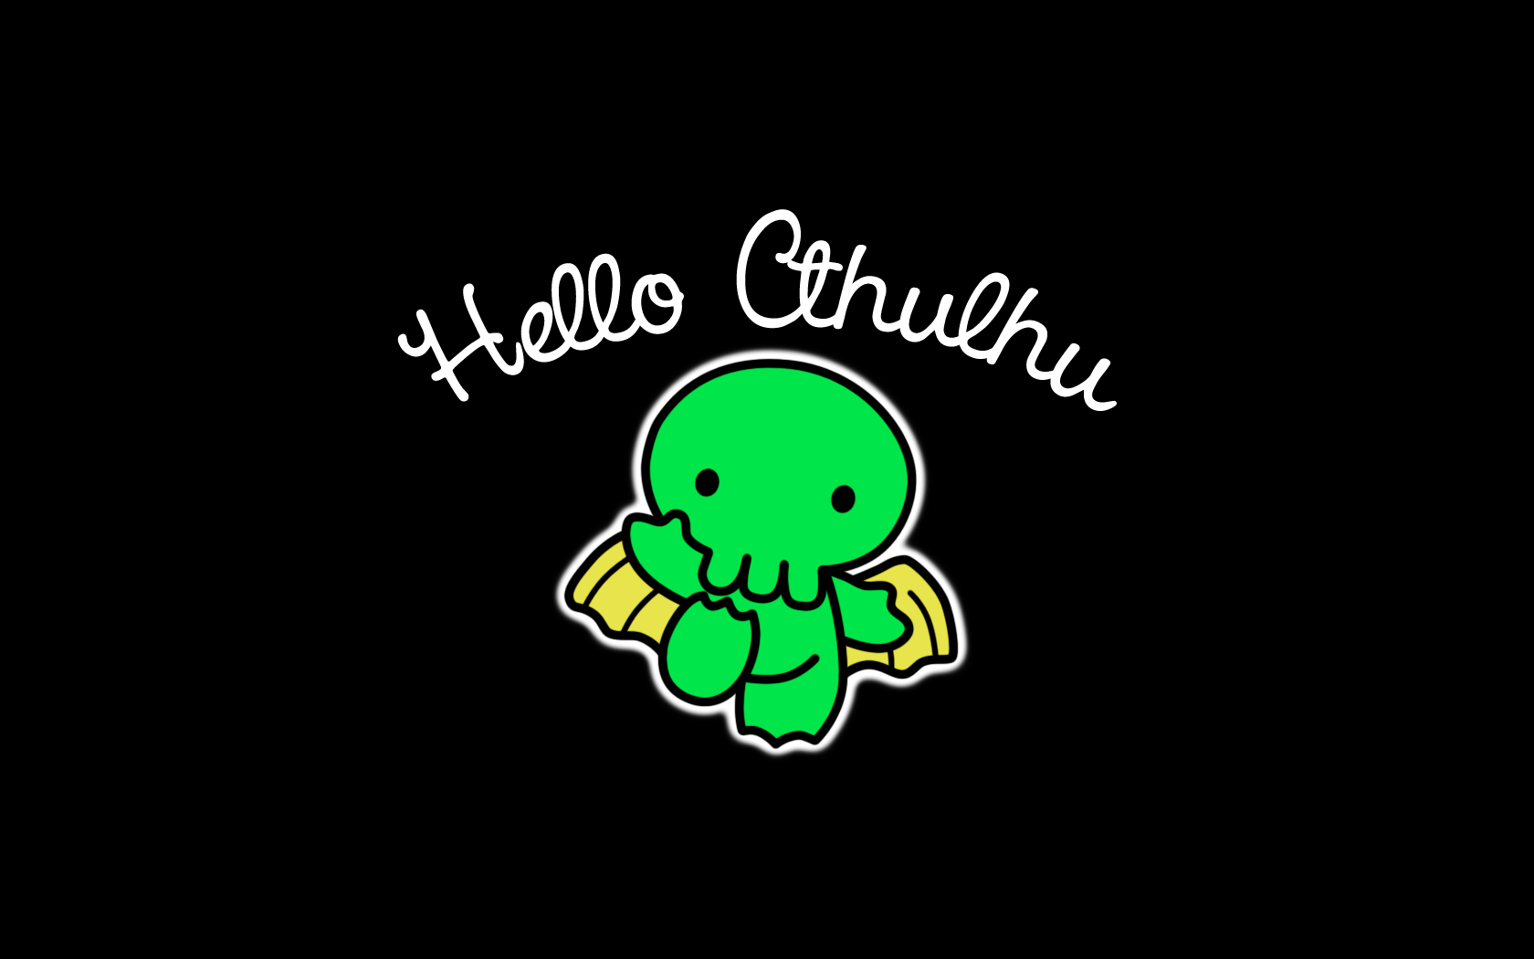
Cthulhu Fan Art

Slide 15

Cthulhu Fan Art

Slide 16
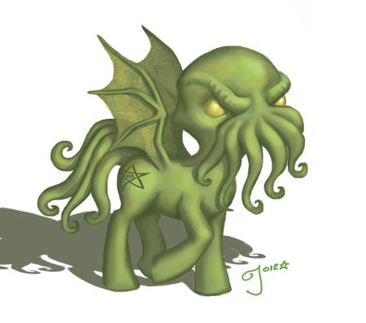
Cthulhu Fan Art

Slide 17

Cthulhu Fan Art

Slide 18
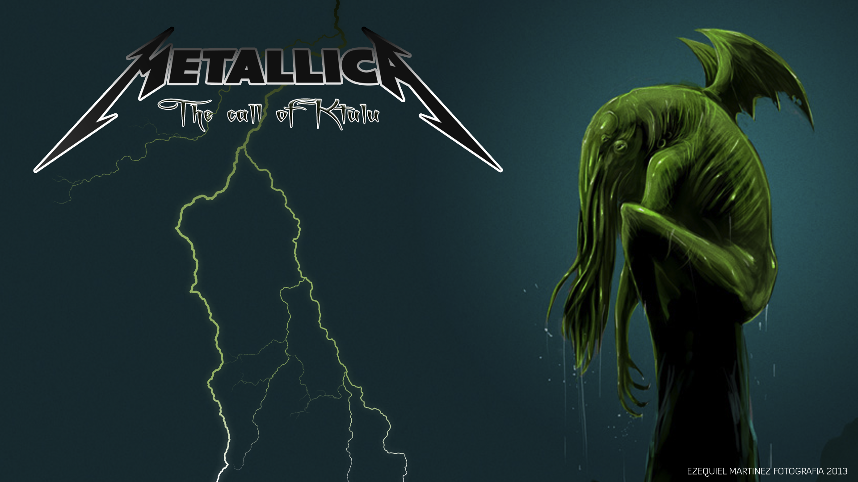
Cthulhu Fan Art

Slide 19

Cthulhu Fan Art

Slide 20
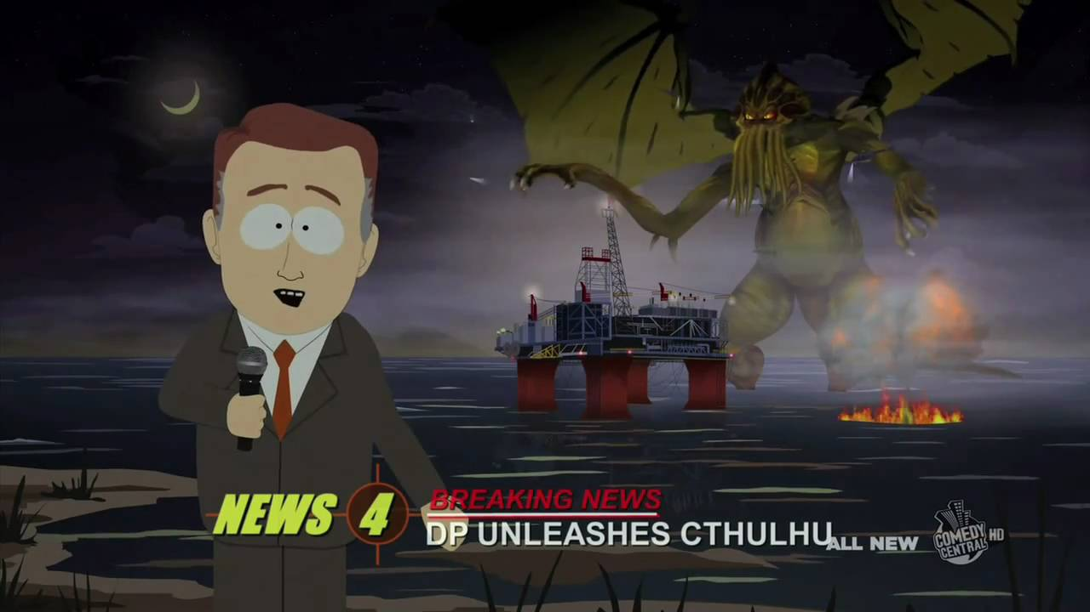
Cthulhu Fan Art (South Park) https://www.youtube.com/watch?v=AsKEPLBgJu0

Slide 21
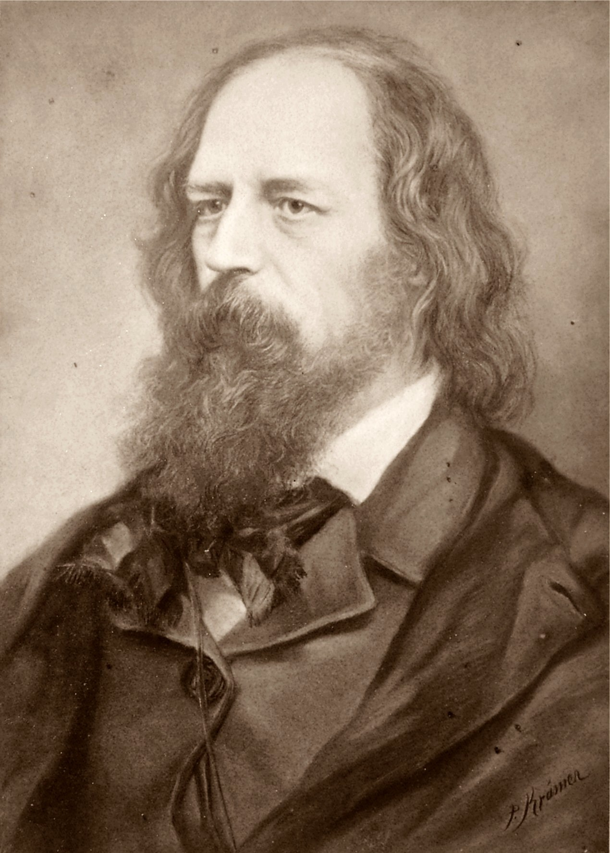
Alfred, Lord Tennyson, “The Kraken” (1830)
Below the thunders of the upper deep, Far, far beneath in the abysmal sea, His ancient, dreamless, uninvaded sleep The Kraken sleepeth: faintest sunlights flee About his shadowy sides; above him swell Huge sponges of millennial growth and height; And far away into the sickly light, From many a wondrous grot and secret cell Unnumbered and enormous polypi Winnow with giant arms the slumbering green. There hath he lain for ages, and will lie Battening upon huge sea worms in his sleep, Until the latter fire shall heat the deep; Then once by man and angels to be seen, In roaring he shall rise and on the surface die.

Slide 22
Signal Question
What is Lovecraft’s narrator so terrified of? How would you describe the style of this story?
Put another way: if this is a “weird” tale, then what in it is weird, abnormal, unusual, strange?

Slide 23
Lovecraft, “Supernatural Horror in Literature” (1927)
“The true weird tale has something more than secret murder, bloody bones, or a sheeted form clanking chains according to rule. A certain atmosphere of breathless and unexplainable dread of outer, unknown forces must be present; and there must be a hint, expressed with a seriousness and portentousness becoming its subject, of that most terrible conception of the human brain--a malign and particular suspension or defeat of those fixed laws of Nature which are our only safeguard against the assaults of chaos and the daemons of unplumbed space.”

Slide 24
Lovecraft, “Supernatural Horror in Literature” (1927)
“The one test of the really weird is simply this—whether or not there be excited in the reader a profound sense of dread, and of contact with unknown spheres and powers; a subtle attitude of awed listening, as if for the beating of black wings or the scratching of outside shapes and entities on the known universe’s utmost rim.”

Slide 25
Science and the “Weird” Tale
Read the first paragraph of “The Call of Cthulhu”:
“The most merciful thing in the world, I think, is the inability of the human mind to correlate all its contents. We live on a placid island of ignorance in the midst of black seas of infinity, and it was not meant that we should voyage far. The sciences, each straining in its own direction, have hitherto harmed us little; but some day the piecing together of dissociated knowledge will open up such terrifying vistas of reality, and of our frightful position therein, that we shall either go mad from the revelation or flee from the light into the peace and safety of a new dark age.”
SIGNAL QUESTION: How does this stand up to Lovecraft’s definition of the “weird” tale? What does it suggest about science’s role in this?

Slide 26
Science and the “Weird” Tale
Now, a final passage from “Supernatural Horror in Literature”:
“For those who relish speculation regarding the future, the tale of supernatural horror provides an interesting field. Combated by a mounting wave of plodding realism, cynical flippancy, and sophisticated disillusionment, it is yet encouraged by a parallel tide of growing mysticism, as developed both through the fatigued reaction of ‘occultists’ and religious fundamentalists against materialistic discovery and through the stimulation of wonder and fancy by such enlarged vistas and broken barriers as modern science has given us with its intra-atomic chemistry, advancing astrophysics, doctrines of relativity, and probings into biology and human thought.”
SIGNAL QUESTION: Compare this passage with the previous one. What is the relation between science and mysticism?

Slide 27
Why is the story made up of so many texts?
Narrator’s Manuscript (Francis Wayland Thurston)
Professor Angell’s Papers Clippings
Henry A. Wilcox John R. Legrasse
Professor Webb Old Castro
Gustaf Johansen Sydney Bulletin

Slide 28
Notes on Language
Phrases used: They, Them, Things, Great Old Ones, Elder Stars, Elder Daemons, Elder Gods
Chant:
“Ph’nglui mglw’nafh Cthulhu R’leyh wgah’nagl fhtagn.”
“In his house at R’leyh dead Cthulhu waits dreaming.”
From Necronomicon:
“That is not dead which can eternal lie,
And with strange aeons even death may die.”

Slide 29
Signal Question
You may have noticed that most—or all—of Cthulhu’s followers are people of color (“Esquimaux,” “mixed-blooded pariahs,” “negroes”). What is the significance of this? Does Cthulhu itself seem linked to race in any way?

Slide 30
Lovecraft’s Legacy: Racism
More terms from “The Call of Cthulhu”:
“nautical-looking negro… from one of the queer dark courts”
“degenerate Esquimaux”
“Esquimaux wizards”
“Louisiana swamp-priests”
“half-castes and pariahs”
“primitive but good-natured descendants of Lafitte’s men”
A region “of traditionally evil repute, substantially unknown and untraversed by white men”
“men of a very low, mixed-blooded, and mentally aberrant type… a sprinkling of Negroes and mulattoes, largely West Indians or Brava Portuguese”

Slide 31
Lovecraft’s Legacy: Racism
And MORE…
“deathless Chinamen”
“voodoo orgy”
“indescribable horde of human abnormality… hybrid spawn”
“mad Arab Abdul Alhazred”
“foreign mongrels”
“a queer and evil-looking crew of Kanakas and half-castes”
“a curious group of half-castes”
“Waterfront scum”
“swarthy cult-fiends”

Slide 32
Signal Question
Beyond the biographical fact of Lovecraft’s racism, what can the text’s obsession with different “Others” tells us about monstrosity? How are they related to Cthulhu in the text, and why?
Is it significant that many of Cthulhu’s followers are “mixed-blooded”?
Is the horror produced by Cthulhu distinct from the narrator’s disgust toward people of color?
Why would a supernatural horror be linked with very real, human categories?

Slide 33
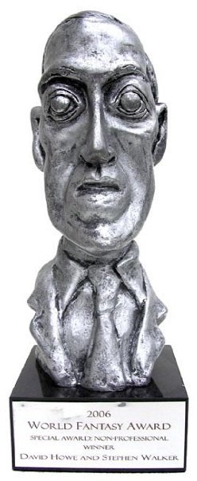
Controversy: World Fantasy Award
Established 1975
Awarded annually
Multiple categories (e.g., novel, novella, short story)
Award: Bust of Lovecraft
Petition created to replace the award (2657 supporters)
Counter-Petition to create Lovecraft monument ($30,000USD in two days)

Slide 34
Lovecraft on Hitler
“[Hitler's] vision is of course romantic & immature, & colored with a fact ignoring emotionalism … There surely is an actual Hitler peril–yet that cannot blind us to the honest rightness of the man’s basic urge … I repeat that there is a great & pressing need behind every one of the major planks of Hitlerism–racial-cultural continuity, conservative cultural ideals, & an escape from the absurdities of Versailles. The crazy thing is not what Adolf wants, but the way he sees it & starts out to get it. I know he’s a clown, but by God, I like the boy!”
--Lovecraft, personal letter (1936)

Slide 35
Common Defense’s of Lovecraft’s Racism
Even Lovecraft’s most ardent fans can’t deny that he was racist; instead, they attempt to demonstrate the unimportance of this fact, with such reasons as:
Everyone was racist back then;
Getting upset about Lovecraft’s racism serves no purpose;
There are many other aspects to Lovecraft’s life and work;
Anyone who knows anything about Lovecraft would be aware that he was a smart guy who was generous to his friends;
“The WFA bust acknowledges Lovecraft’s literary status in the field of weird fiction and nothing more.”
“If his racism was necessary for him to create those brilliant works of art, than [sic] thank god for his racism.”

Slide 36
Signal Question
Are any of the listed defenses of Lovecraft reasonable? Can you think of any compelling defenses of his work? If not, what do you think should be done? (e.g., should people stop buying his books, reading his novels, teaching his stories? Should WFA change its statue?)

Slide 37

Responses
WFA Award Winner
Nnedi Okorafor:
"I put it out of sight, in my study, where only I can see it, and I have turned it to face the wall. So I am punishing the little fucker like the malevolent clown he was, I can look at it and remember the honour, and above all I am writing behind Lovecraft’s back.”

Slide 38

Responses
WFA Award Winner China Miéville:
“The depth and viciousness of Lovecraft’s racism is known to me …It goes further, in my opinion, than ‘merely’ *being* a racist. . . . Lovecraft’s oeuvre, his work itself, is inspired by and deeply structured with race hatred. [It] is racism itself that raises in Lovecraft a ‘poetic trance’."

Slide 39
Responses
“Of all the people currently expressing their reservations about Lovecraft and the WFA trophy, I’ve yet to find one who’s telling others to stop reading him. In fact, most of these critics continue to enjoy his work for its imaginative scope, gothic sensibility and any number of other reasons. The World Fantasy Award, however, is another matter. It’s an expression of the values of a community, not a reader’s private choice. When Joshi writes, ‘If Nnedi Okorafor and China Miéville are so offended at owning the WFA, they should simply return it and be done with the matter,’ he is essentially telling writers like Okorafor that they must accept an honor from that community in the form of a man who considered them to be “semi-human” and filled “with vice.” Suck it up, or get out. I’m pretty sure this is not the message the World Fantasy Convention meant to send when they gave Okorafor the prize in the first place.”
--Laura Miller, writing for Salon (2014)

Slide 40
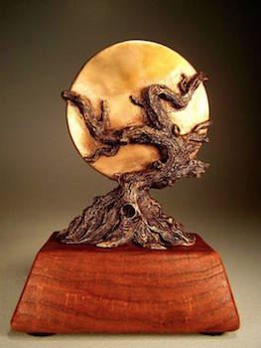
World Fantasy Award
New trophy since 2016
Designed by Vincent Villafranca
Official comment:
“The Board of the World Fantasy Convention and the Awards Administration would like to thank world-famous artist Gahan Wilson, who sculpted the original WFA Statuette. The bust of HP Lovecraft, which was in use for more than four decades, was donated in perpetuity and will continue to live on in the shape of the nominee pins given out to all those shortlisted for a World Fantasy Award.”

Slide 41
